Slide 1
Petri Net:
A WebGME Design Studio
Diego Manzanas Lopez, Ayana Wild, Carlos Olea
Model Integrated Computing
Fall 2019
Vanderbilt University

Slide 2
Outline
Petri Nets
Overview
Intro
Syntax
WebGME
Metamodel
Semantics
Examples
Simulation

Slide 3
Introduction
What is a Petri Net?
A graphical and mathematical modeling tool used to describe and study information processing systems of various types, like communication systems.
It is widely used in CS and other engineering disciplines to model the dynamics of behavioral systems such as distributed systems.
Place 1
Arc 1
Transition
Arc 2
Place 2

Slide 4
Components
Places
Represented by circles
Describe states, conditions or resources to be met.
Marking (tokens)
Transitions
Represented by rectangles
Describe actions in the net.
Arcs
Directed connections between transitions and places.

Slide 5


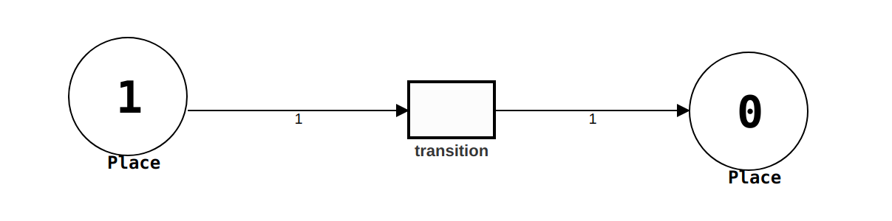

Behavior of Petri Nets
How do the tokens move from place to place?
Firing rule
Multiplicity (arcs)
Current tokens
Incoming arcs to transitions

Slide 6

WebGME
What is WebGME?
Design studio tool
Goal: provide a framework to develop more interdisciplinary design studios.
https://webgme.org/
https://github.com/webgme/webgme/wiki

Slide 7
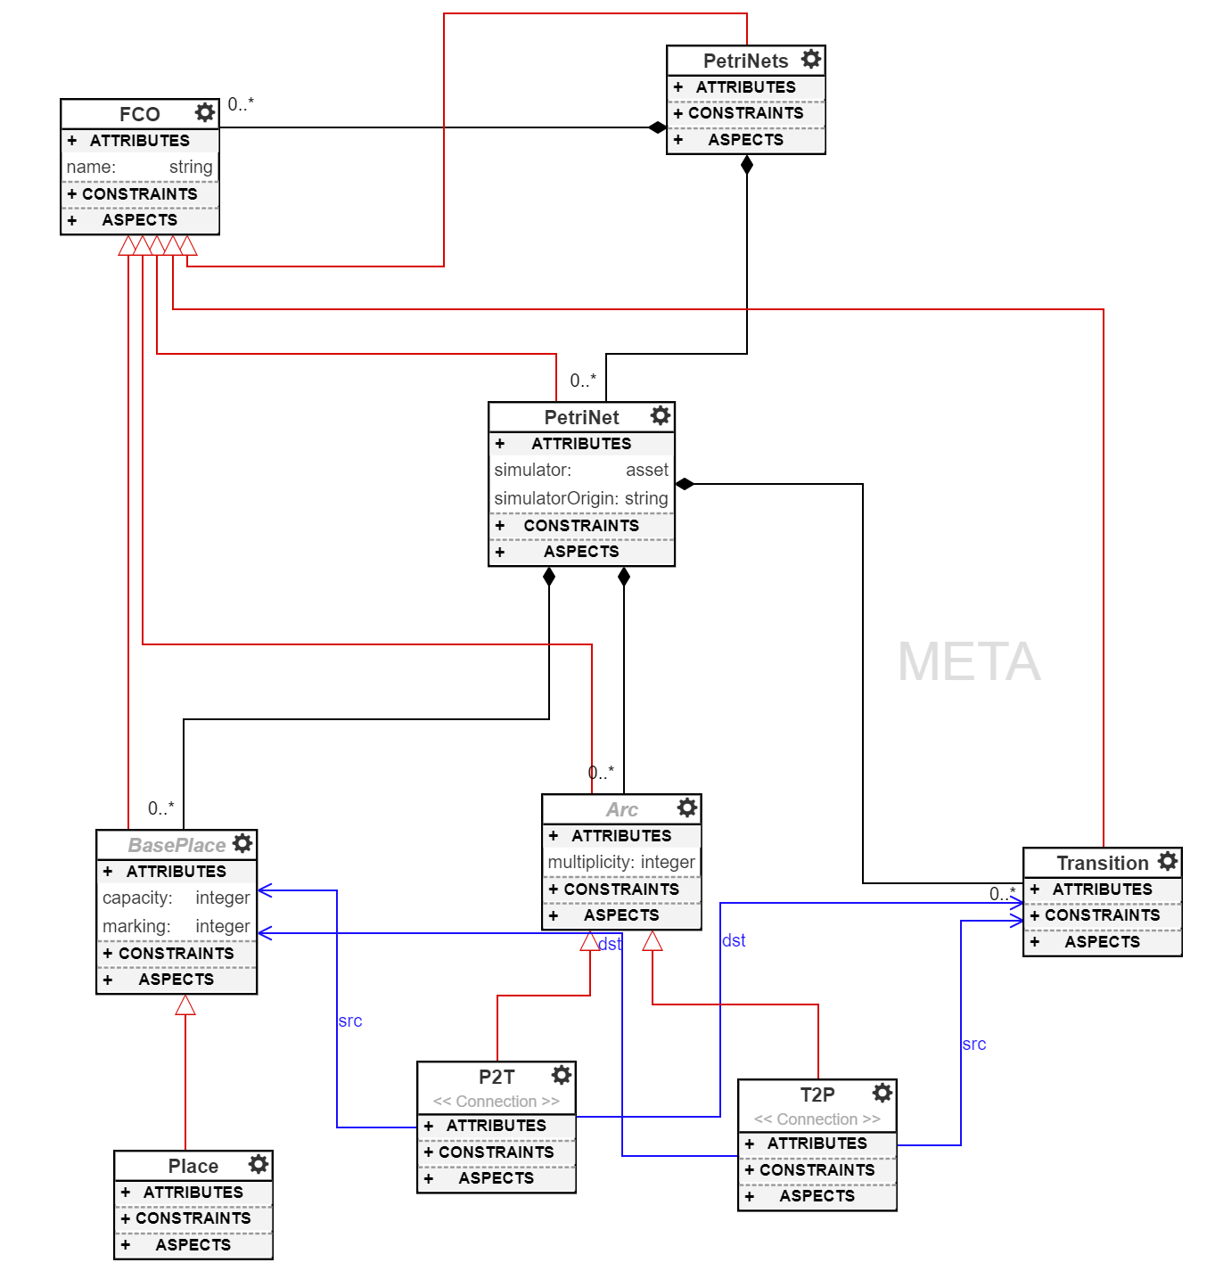
Metamodel
Default values for attributes:
capacity = 1
marking = 0
multiplicity = 1
PetriNet's attributes:
simulator and simulatorOrigin – assets used for simulating the Petri Net within the PetriNetSim visualizer

Slide 8
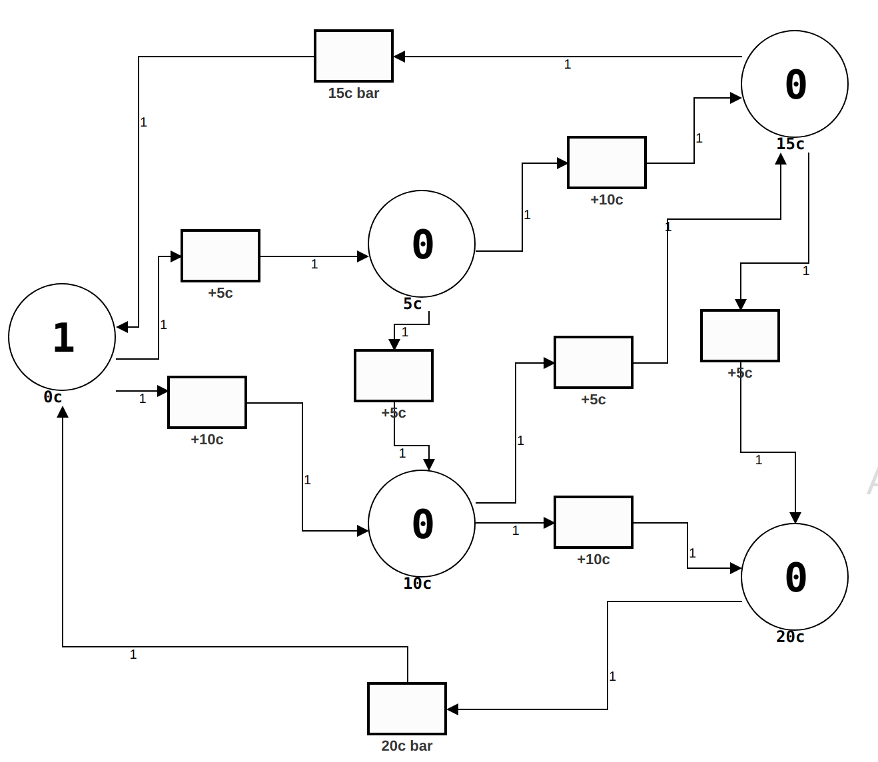
Examples
Vending Machine

Slide 9
Simulations
Created a visualizer to provide the design studio with simulation capabilities.
This is still part of the ongoing work and will show how this will look in WebGME.
Allow the user to see tokens movement.
Interact with the Petri Net
Illustrate this with the Vending Machine

Slide 10
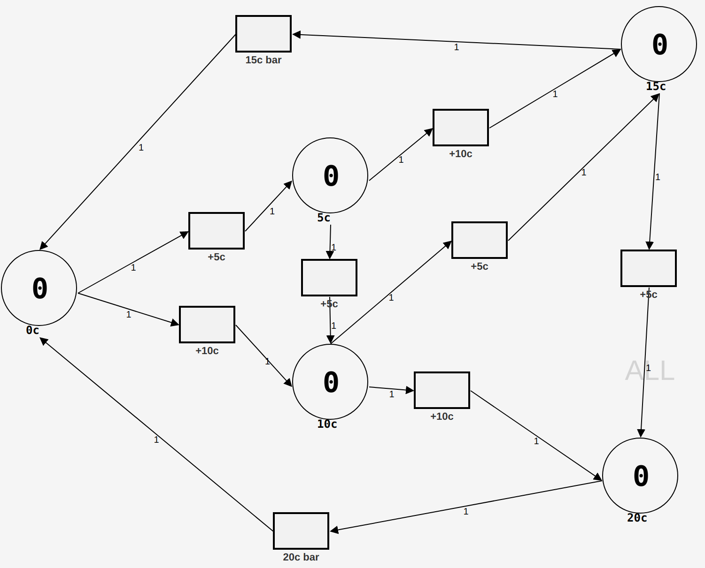
Simulations
Initial state:
1 Token at place 0c
1

Slide 11
Simulations
Token fired to transition +10c

Slide 12
Simulations
1 Token at place 10c
1

Slide 13
Simulations
Token fired to transition +5c

Slide 14
Simulations
1
1 Token at place 15c

Slide 15
Simulations
Token fired to transition 15c bar

Slide 16
Simulations
Back to initial position
1 Token at place 0c
1

Slide 17
Live Demo
Current status of the tool
Plugin execution
Examples
Simulation

Slide 18
Summary
Built a design studio for general Petri Nets.
Provide a plugin and simulator to reason about Petri nets.
Target audience:
People interested in reasoning about dead locks and other properties of Petri nets.
Developers who want to build a design studio for other complex Petri net models to build upon this one.

Slide 19
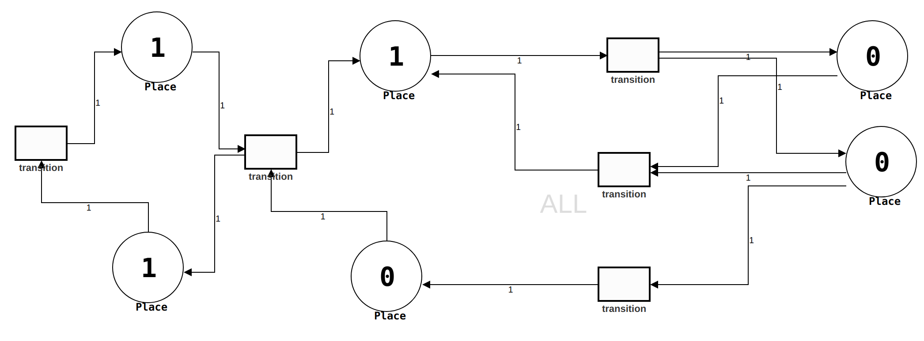
Future Work
Music et al 2012

Slide 20
Future Work
Add variations to the general model of Petri Nets. High-level Petri Nets:
Colored Petri Net
Extended Petri Nets (inhibitors)
Finite capacity Petri Nets
Add more plugins to check for finite or infinite executions, check for deterministic or nondeterministic Petri Nets, and more.
Notes:
Colored Petri nets – Add a distinction between tokens. Could add multiple numbers inside a place, each with different color, nstead of just one number.
High level Petri Nets are those that given the same structure of a Petri Net, they are able to carry more information
Extended Petri nets are characterized by the addition of an element called inhibitor to its arcs. This can be enable or disable, depending if it allows the flow of tokens thru the arc.
Finite capacity is such that the amount of tokens cannot go to infinity, the max capacity for each place is capped to a certain limit.

